Slide 1




Slide 2



INTERNET AND WEB PROGRAMMING PROJECT
COURSE CODE: CSE-3109
DATE: 5. 06. 2026

Slide 3
Our
Supervised by
T
Prof. MD. AMINUL ISLAM Associate Professor
Department of Computer Science & Engineering
Jagannath University
M
E
A

Slide 4
Our
T
E
A
M

Slide 5


Tasfia Tasnim Id : -------------
Atik Jawad Id : --------------

Slide 6






C O N T E N T S
Introduction
Problem & Solution
Architecture overview
Features & implementation
Future Improvements
Conclusion

Slide 7





Introduction
Problem Statement
The traditional হালখাতা (halkhata) is a handwritten credit ledger used for generations by small shop owners across Bangladesh to track customer purchases and repayments.
হালখাতা Digital is a web-based shop management system developed to modernize this process while keeping the workflow familiar to Bangladeshi shop owners.
Built For
Small & medium retail shop owners who currently rely on paper-based credit tracking
Digital replacement of the traditional paper halkhata
Responsive interface with Bengali language support
Tracks customer credit, payments, inventory, suppliers, and expenses
Core Idea
One customer. One running balance. One always-current source of truth.

Slide 8


Problem Statement
System Architecture
Traditional Problems
Our Solution
Ledgers lost, torn, or damaged with no backup
Secure SQLite storage with one-click JSON backup
Manual balance calculations prone to error
Balances computed automatically — zero manual math
No way to generate monthly / yearly summaries
Monthly & yearly reports generated in one click
Stock levels untracked and disconnected from sales
Batch-aware inventory linked directly to every sale
Customer history buried across many notebook pages
Instant search across every customer and transaction

Slide 9







Technology Stack
System Architecture
User
Browser
A shop owner's action in the browser sends a JSON request through Express.js, which validates it, applies business rules, and reads or writes the SQLite database before returning an updated result — all without a full page reload.
Frontend — HTML5 · CSS3 · JavaScript
How a request flows
Express.js
Backend — Node.js
SQLite Database

Slide 10






Technology Stack
Database Schemas
FRONT-END
Structured the application's pages and user interface.
BACK-END
Provided the server-side
runtime environment to
execute JavaScript on the backend.
Designed a responsive, clean, and modern user interface.
DATABASE
Lightweight relational database used to securely store all application data locally.
Client-side logic, interactivity, and API communication without external frameworks.
Simplified backend development by handling routing, APIs, and HTTP requests.
FRONT-END Library
Generated interactive charts and business analytics for the dashboard and reports.
07

Slide 11







Database Design
Features
Customers
Settings
SQLite
Database
Transactions
Users
Expenses
Inventory
Inventory
Batches
products
Suppliers
Supplier Transactions
08

Slide 12



Features
Workflow (User Journey)
হালখাতা Digital delivers the complete lifecycle of small-business credit management in a single, lightweight web application.
Customer Ledger Profiles, balances & trust score
Smart Reports Monthly & yearly analytics with charts
Sales & Credit Cash sales, credit sales, repayments
Multi-Branch/ shop support One account, many shop locations
Supplier Ledger Track dues owed to wholesalers
PWA Support Instant home-screen access with app-like experience
Batch Inventory FIFO stock across purchase batches
Batch Inventory FIFO stock across purchase batches

Slide 13
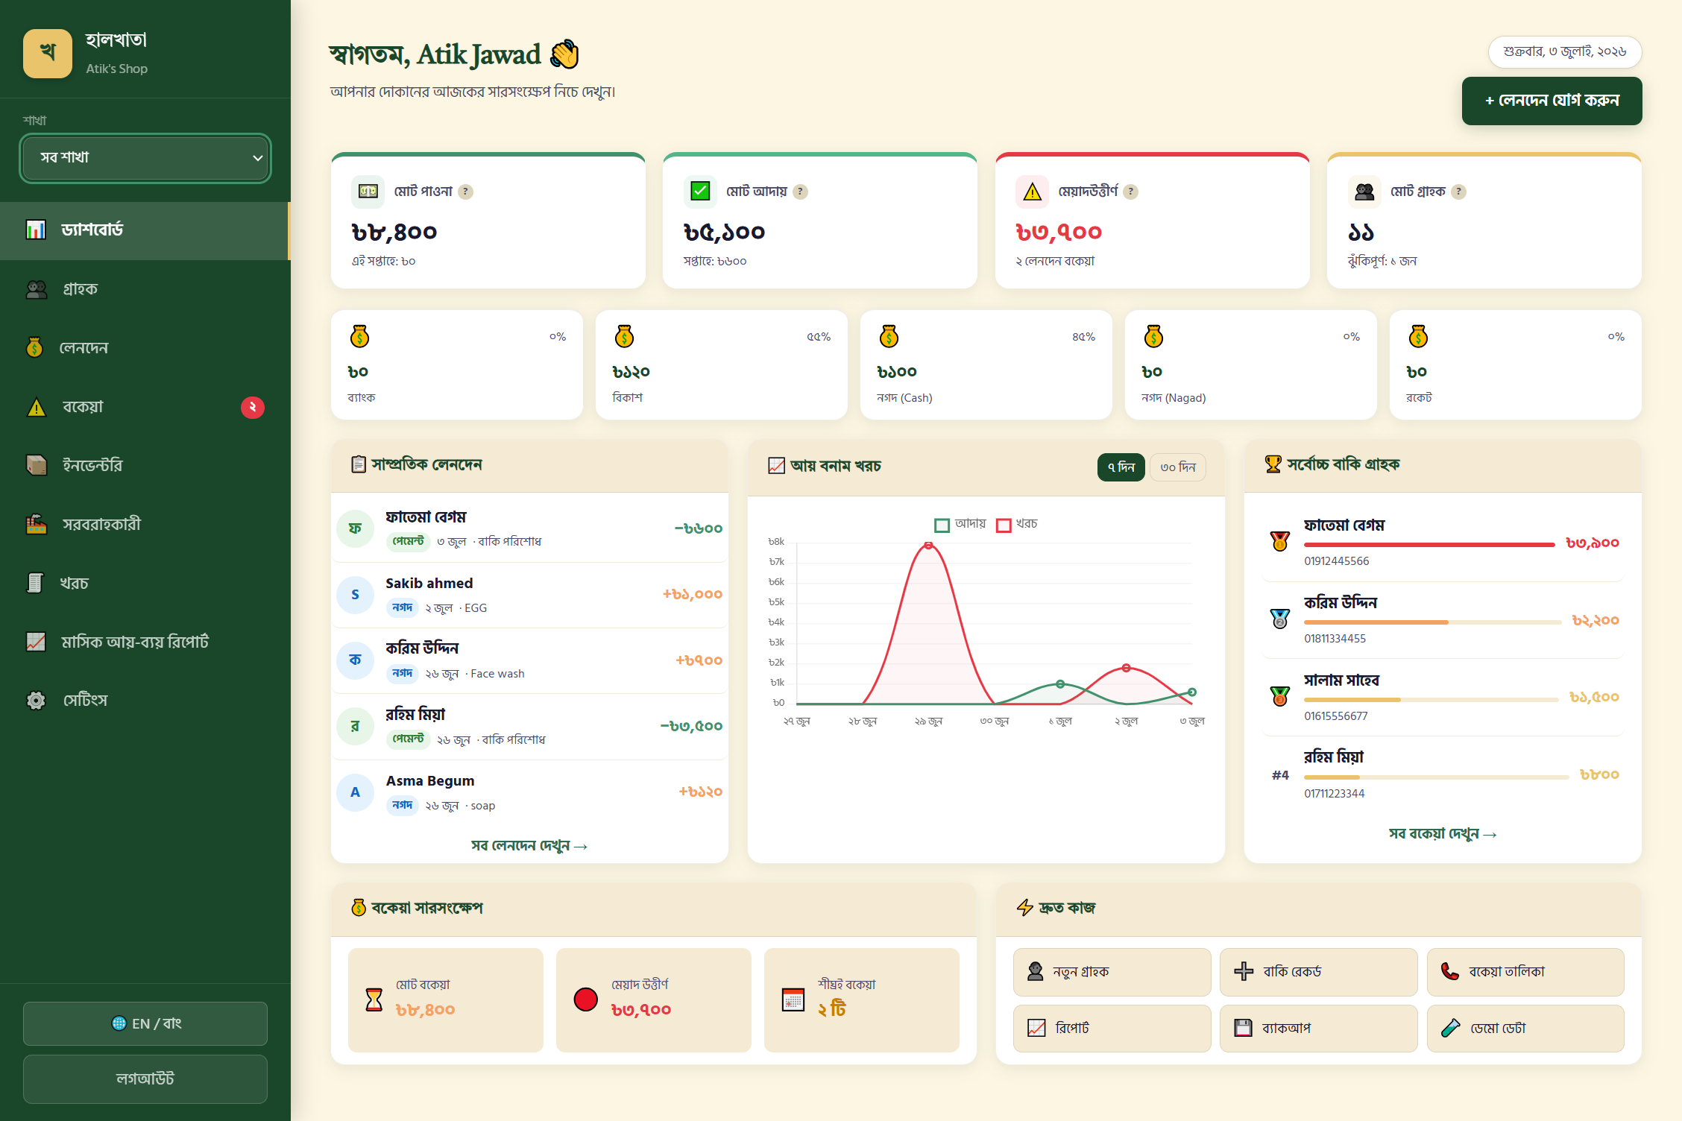
Workflow (User Journey)
UI at a glance
Customers
User (Shop Owner)
Transactions
🎯
Make Smart
BUSINESS DECISIONS
🔐
LogIn/
SignUp
Yes
Dashboard
Choose Shop
Inventory
Reports & analytics
Authenticated
?
No
Suppliers
Expense

Slide 14
UI at a glance
Dashboard
Live totals: receivable, collected & overdue amounts
Recent transactions feed, updated in real time
Ranked list of highest-due customers
Short-term income vs. expense trend chart
One-tap branch switcher across every widget
09

Slide 15
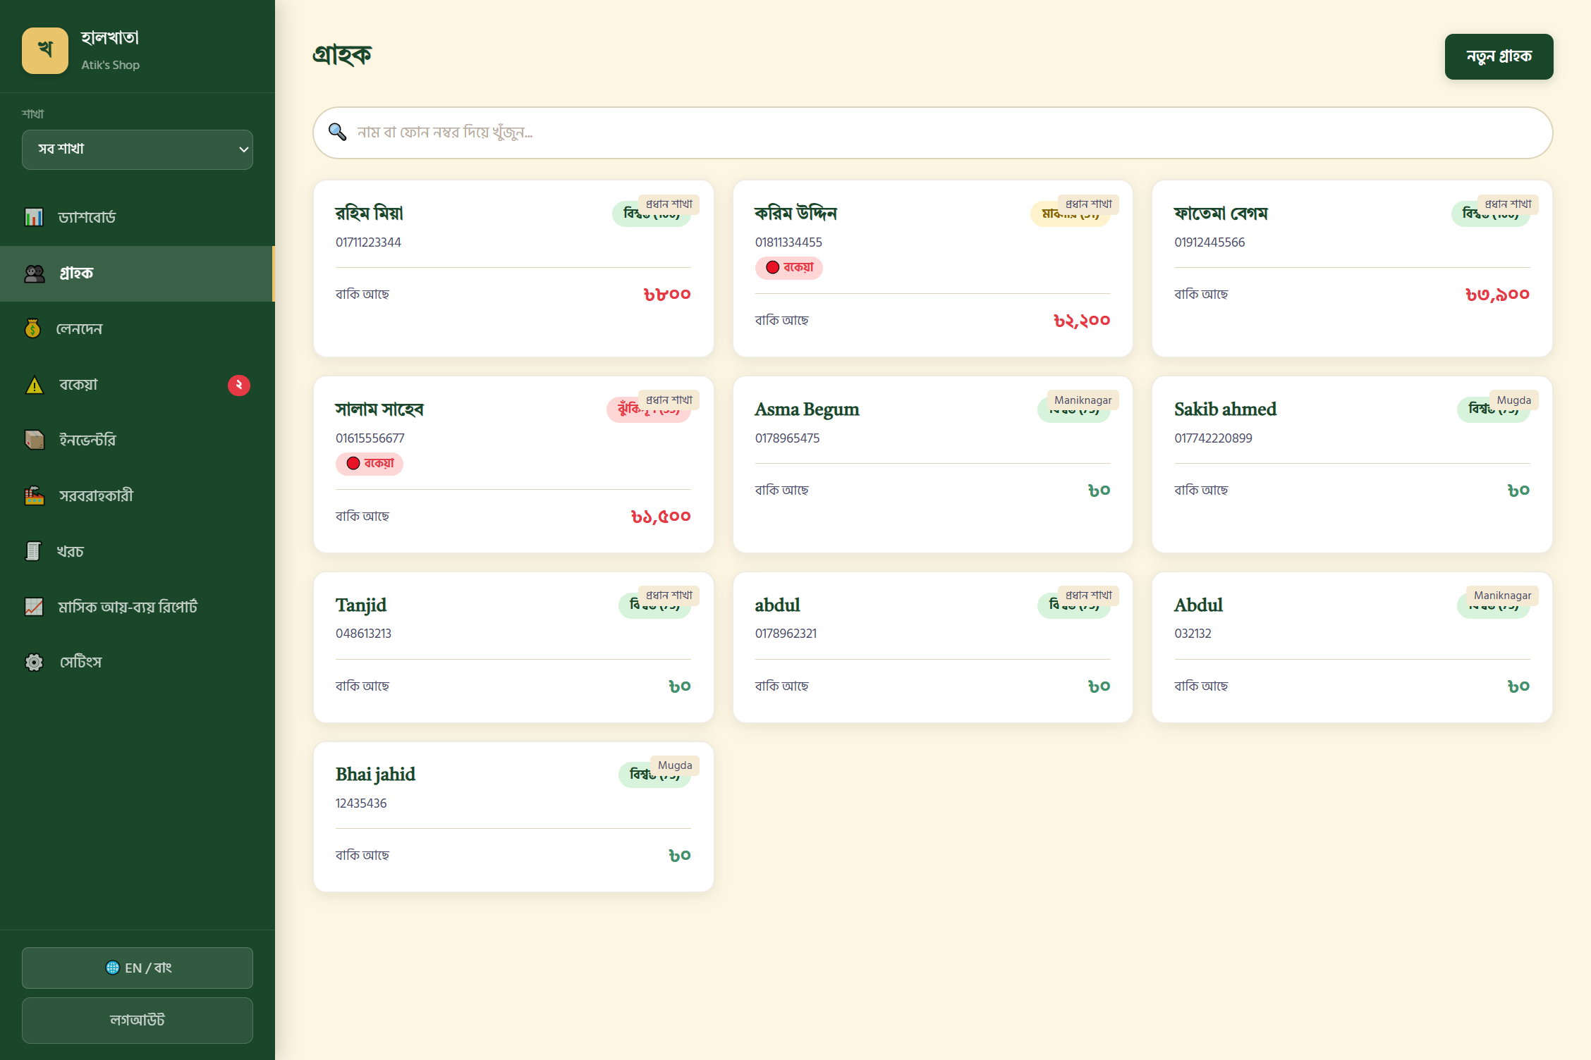
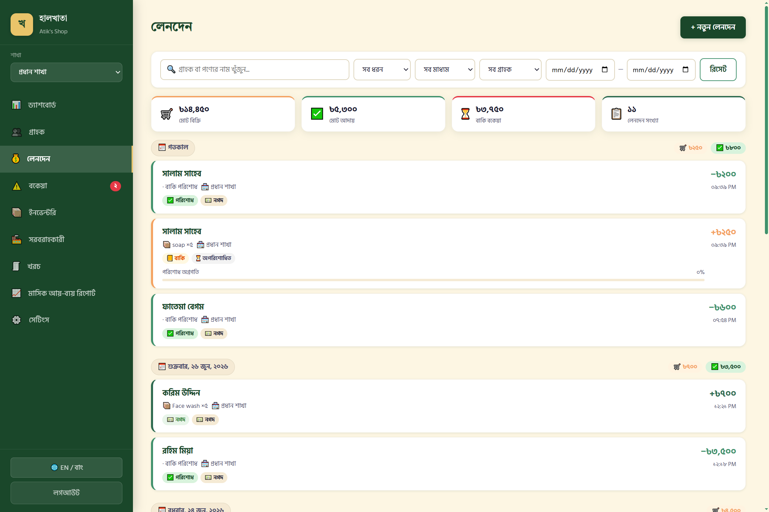
UI at a Glance
Customers
Transactions
Screenshot Placeholder
Customer & Transaction View
10

Slide 16
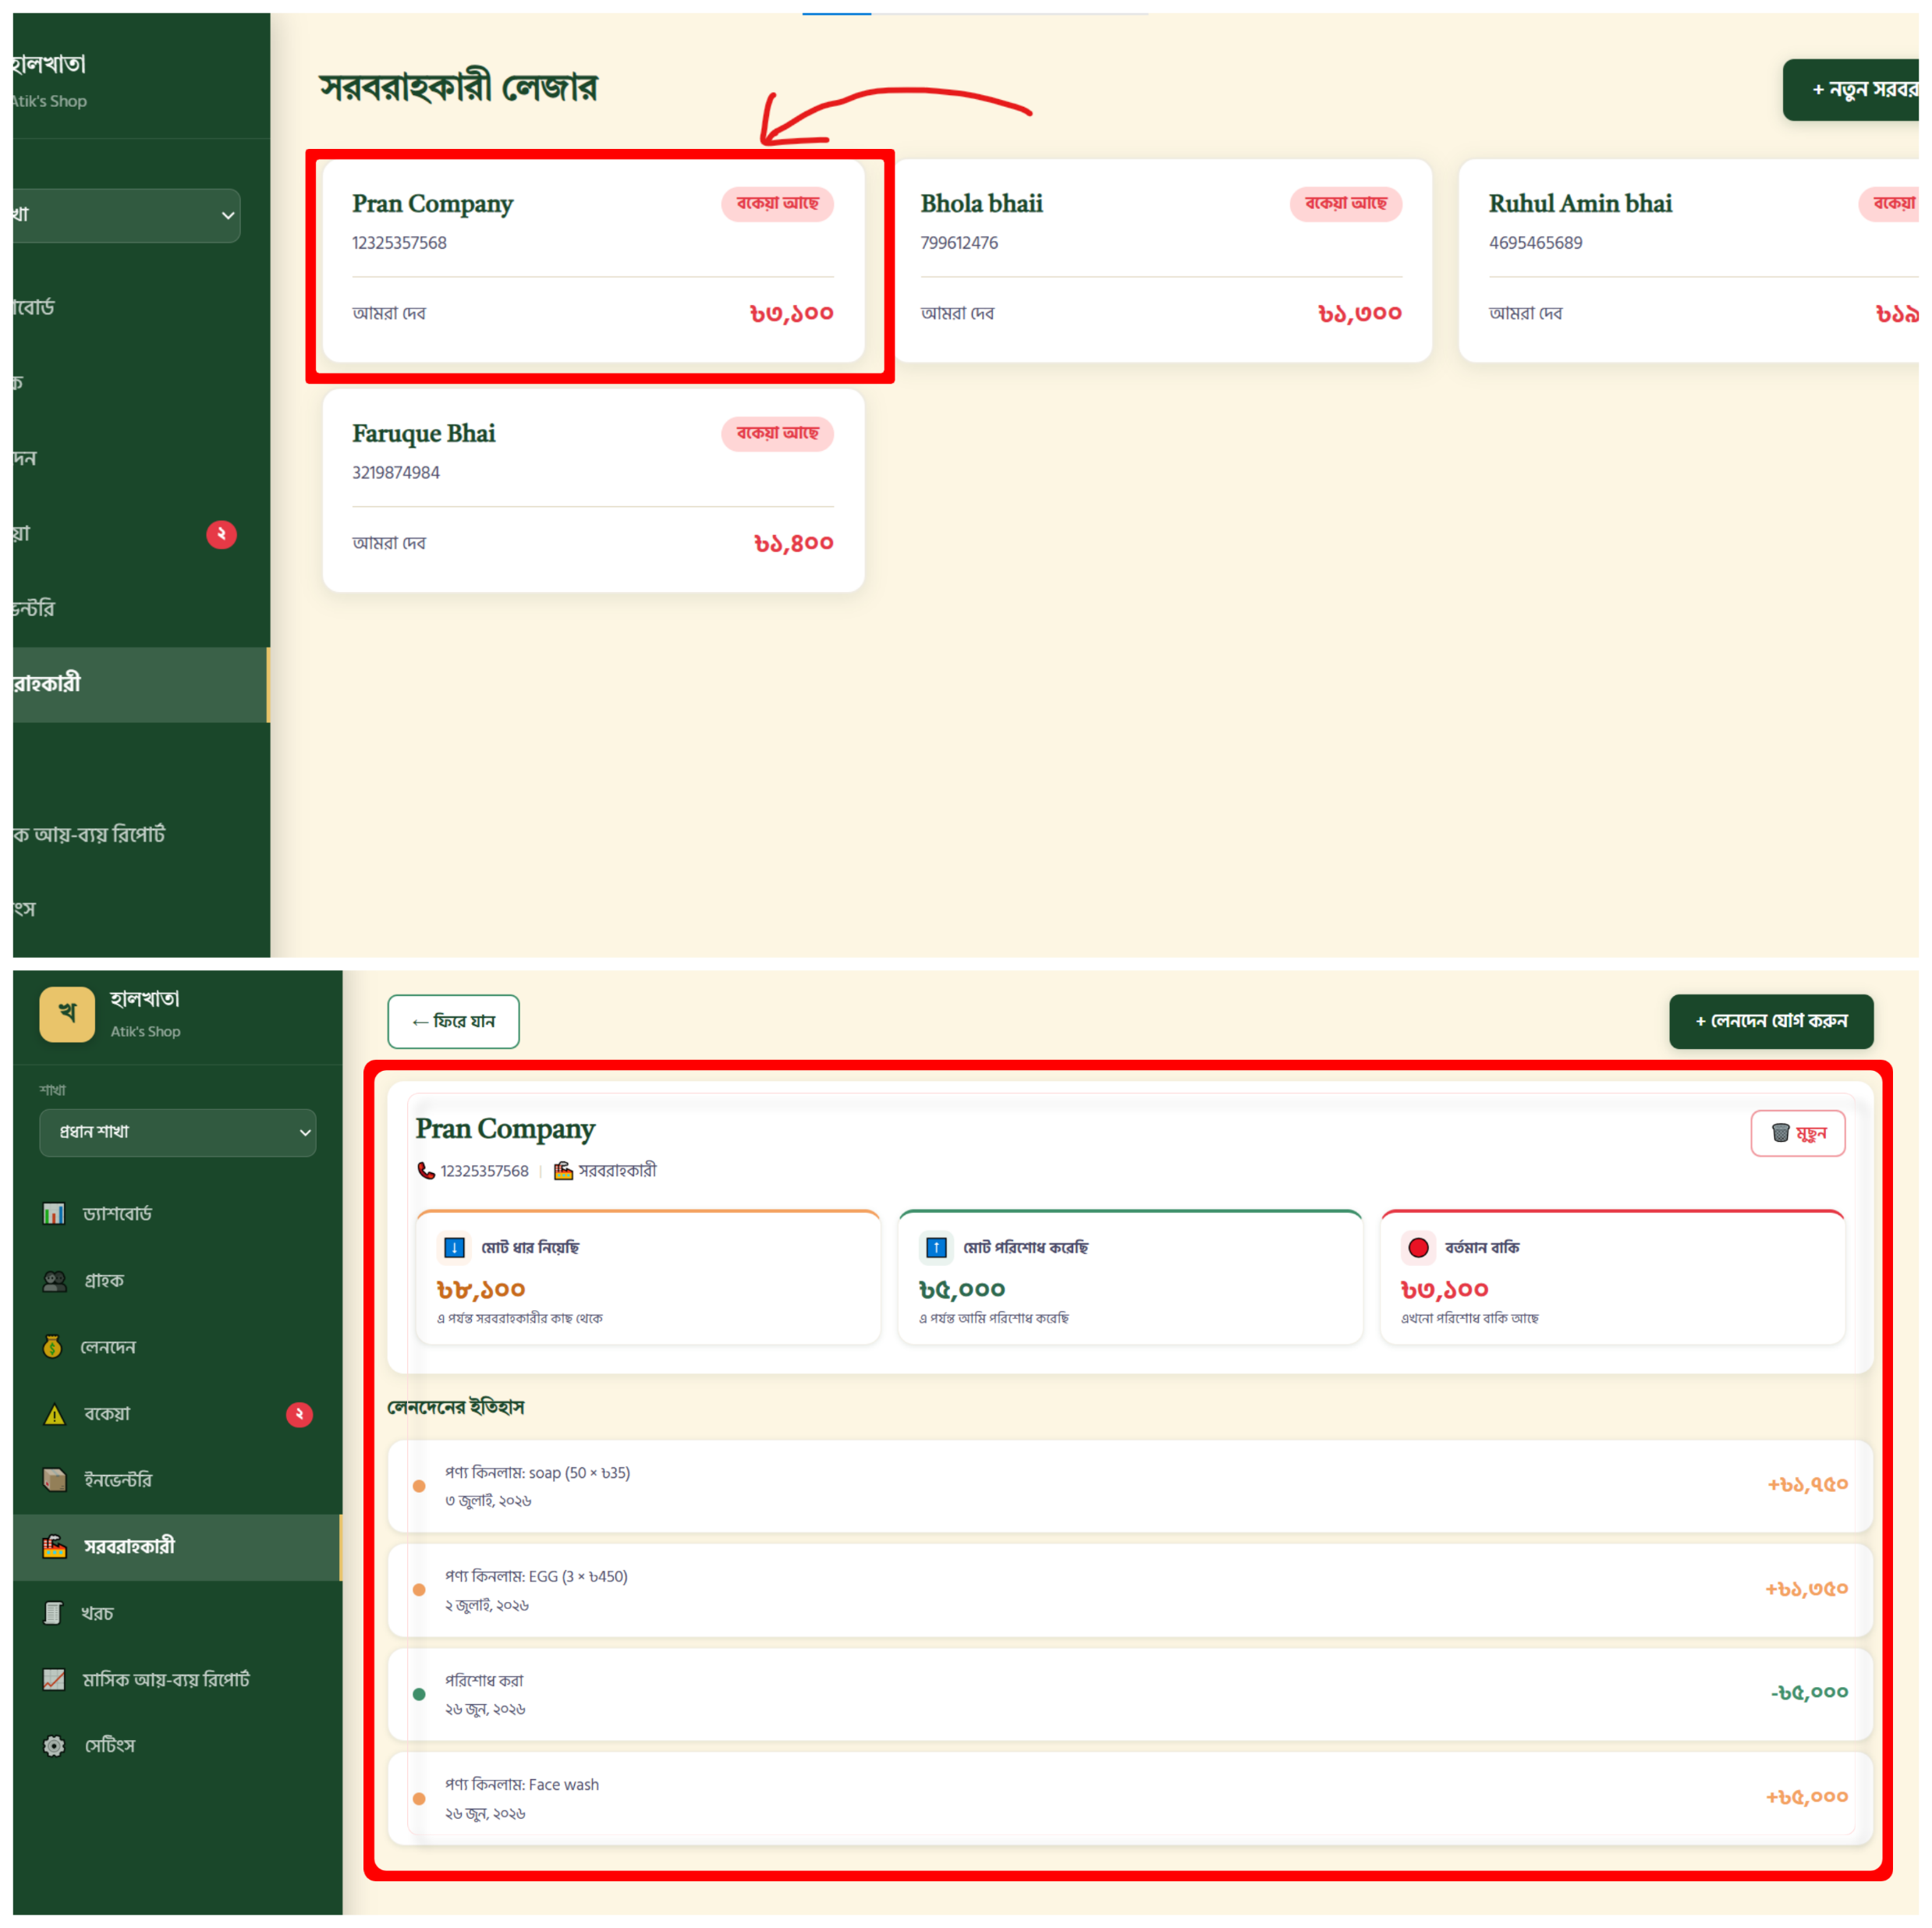
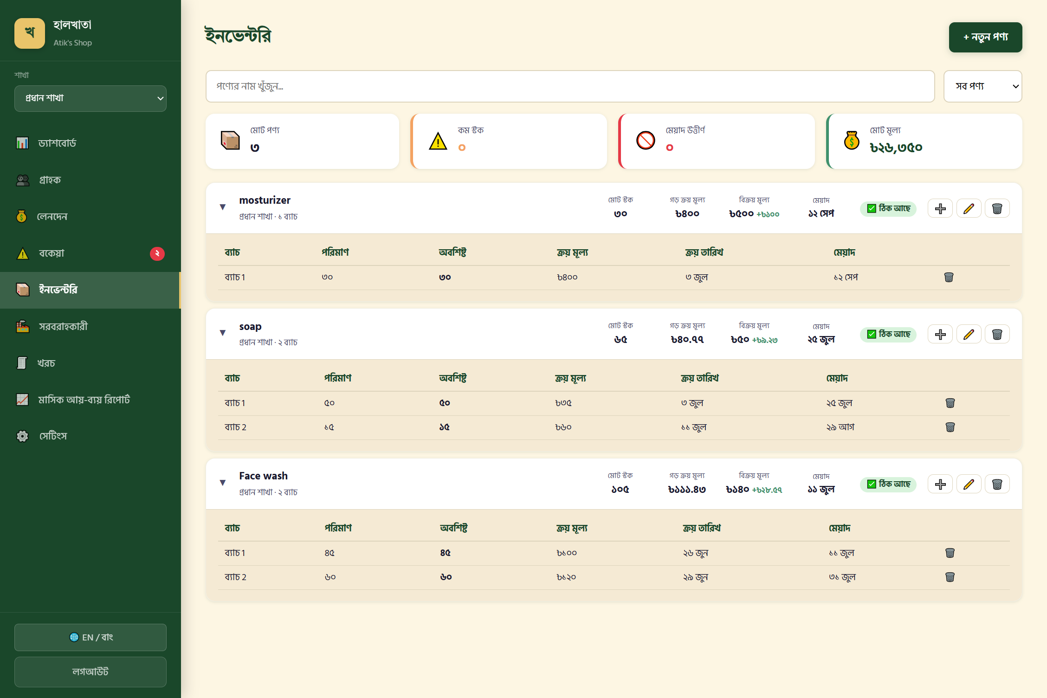
UI at a Glance
Supplier Ledger
Inventory
10

Slide 17
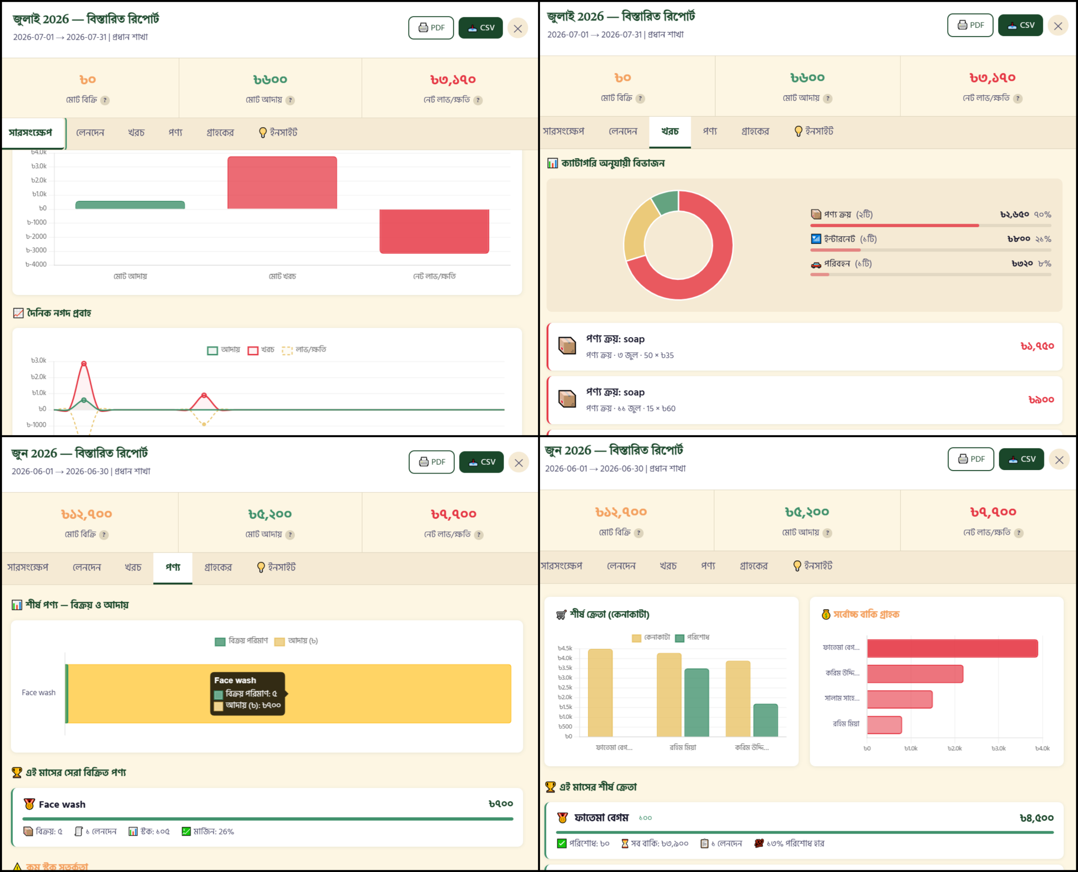
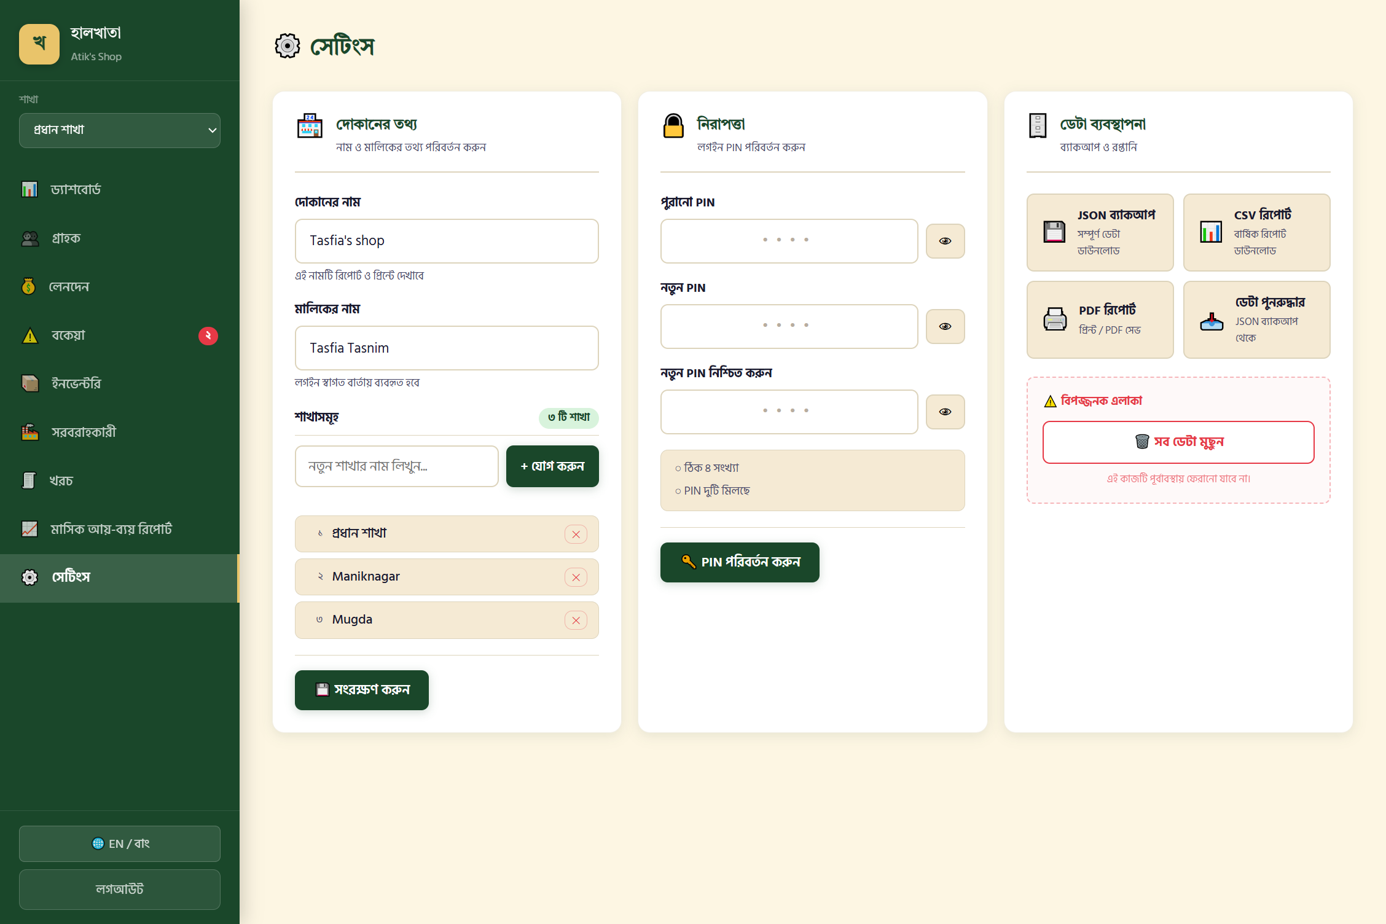









UI at a Glance
Future Improvements
Reports & Analytics
Authentication & Settings
10
Offline Support
Android App
Multi-Language UI
Barcode / QR Scan
Cloud Sync
SMS Notifications
Dark Mode
Advanced Analytics
AI Prediction
Multi-Employee Roles

Slide 18
Future Improvements
Conclusion
Offline Support
Android App
Multi-Language UI
Barcode / QR Scan
Cloud Sync
SMS Notifications
Dark Mode
Advanced Analytics
AI Prediction
Multi-Employee Roles
14

Slide 19

Conclusion
Objectives
Achievements
Future Scope
Digitize the paper halkhata workflow
Full sales, credit & repayment engine
Offline-first mobile experience
Automate balances & credit tracking
Batch inventory with FIFO logic
Native Android & iOS apps
Deliver reporting without manual work
Multi-user, multi-branch architecture
AI-driven credit risk prediction
15

Slide 20
Thank You

